Slide 1
Inventory Management System
DONE BY
HEMALAKSHMI D

Slide 2
Abstract:
This project is a console-based Inventory Management System built on Java (OOP) and MySQL for secure stock management. The system enforces a Dual-Access Security Model: requiring Admin Login for full CRUD operations, while providing Read-Only access for guests. This architecture ensures stability and accurate inventory tracking.

Slide 3
Technology Stack:
The system is built on industry-standard technologies:
Java: Used for application logic and implementing OOP principles.
MySQL: Provides persistent, relational data storage.
Apache Maven: Manages dependencies (JUnit 5, Logback) and handles the project build process.
JDBC: Serves as the secure API layer connecting our Java code to the MySQL database.
JUnit 5: The core framework for verifying all data access logic DAO through rigorous Integration Testing.

Slide 4
Architecture and Design Principles:
The architecture uses a clear Layered Structure (DAO Model) to maintain separation of concerns.
Singleton Pattern: Implemented in the DBConnection.java class to ensure that only one instance of the connection provider exists, optimizing database resource usage.
OOP: Principles like Encapsulation are enforced in the Product.java model.
Data Modeling: The database design follows a One-to-Many (1:N) relationship, linking One User to Many Products.

Slide 5
Implementation: Security & Access Control:
The system implements a strong security gate by separating user roles:
Admin Access: Secured by a mandatory login screen where the UserDAO verifies credentials. Only authenticated Admins gain access to the Full CRUD menu.
Customer/Guest Access: Provides a publicly available Read-Only view of the inventory, bypassing the password check to enhance user experience.
Protection: SQL queries across all DAO methods use Parameterized Statements to prevent SQL injection vulnerabilities.

Slide 6
Implementation:
ID Synchronization: Utilized JDBC’s Statement.RETURN_GENERATED_KEYS feature to safely retrieve the unique ID generated by MySQL, ensuring the Java object always has the correct key.
Resource Management: The try-with-resources statement is used throughout the DAO to guarantee that JDBC connections are closed automatically, preventing leaks.
Testing: The ProductDAOTest suite proves that the entire CRUD lifecycle is reliable and that the Java application and MySQL database synchronize data accurately.
Error Handling: Logging (using SLF4J) and specific catch blocks handle failures gracefully, ensuring system stability.

Slide 7
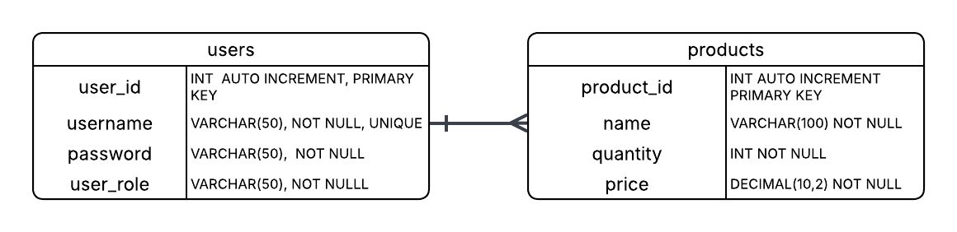
ER Diagram:

Slide 8
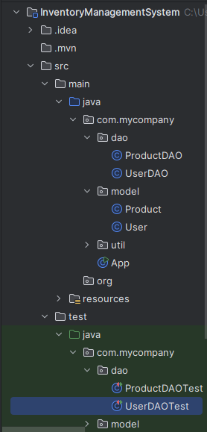


Outputs:
PROJECT STRUCTURE
TABLES

Slide 9
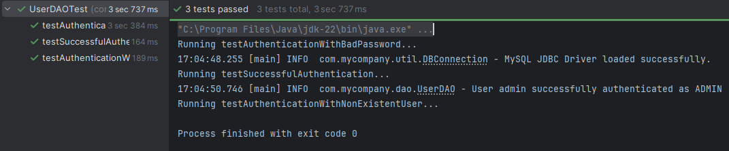
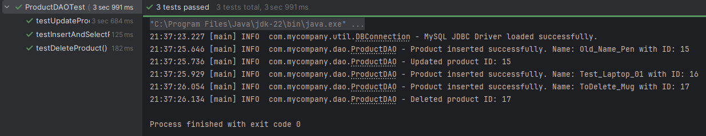
Outputs:

Slide 10
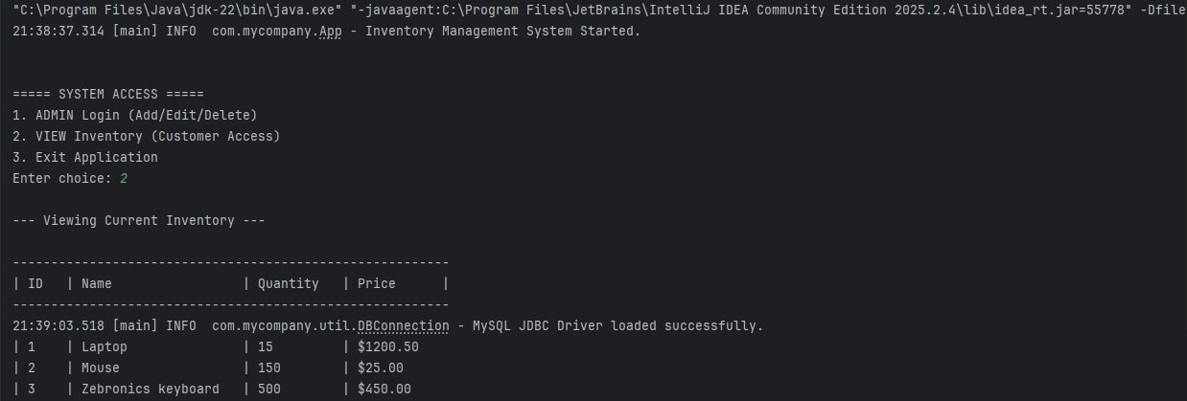
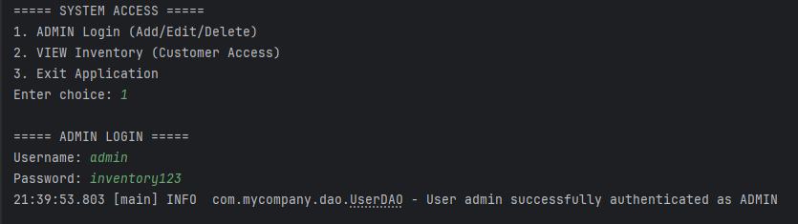
Outputs:

Slide 11
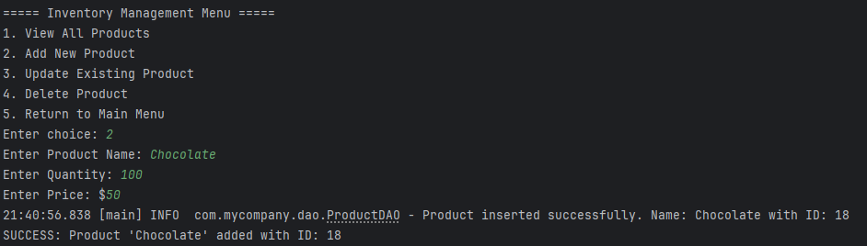
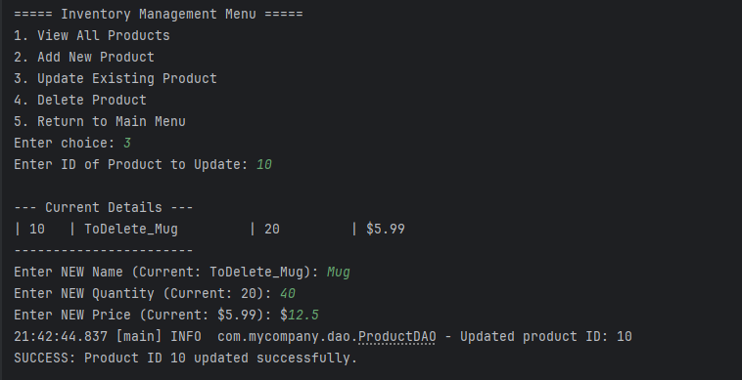
Outputs:

Slide 12
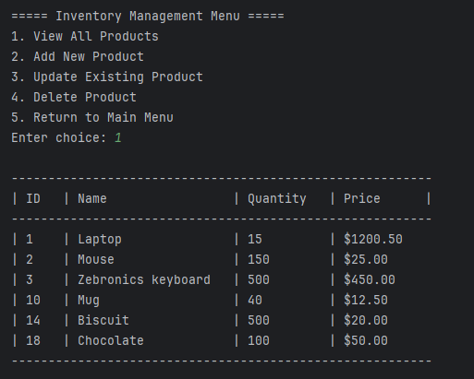
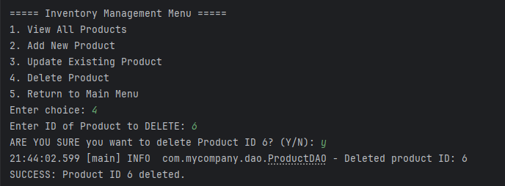
Outputs:

Slide 13
Future Enhancements:
Implement role-based access control(Warehouse Staff and Auditor)
Stock location and tracking
Inventory history/audit trail
Inventory search

Slide 14
THANK YOU

